Slide 1
Is it possible to learn TRIZ in two hours?
© 2015, Andrej Trebar
Notes:
This presentation provides an example of how to prepare educational courses to use TRIZ crossover QMS Android mobile application for quality improvements in development and improvement of Quality Management Systems, processes, procedures and services. It has the role of being a creative booster encouraging users to select inventive principles for solutions and implement the right method for their implementation. The TRIZ crossover QMS (Theory of Inventive Problem Solving x Quality Management System) solution enables the application of TRIZ tools and techniques in the world of quality management. It was developed to improve the creativity of manager teams and individuals.
Valery Krasnoslobodtsev and Richard Langevin describe the difference between Six Sigma and TRIZ in the article Applied TRIZ In High-Tech Industry. Quote:“Six Sigma is efficient for finding the best trade-off solutions, TRIZ goes for overcoming contradiction. Six Sigma is efficient to find out the main factor of the problem but Six Sigma cannot answer “How to Do” in many problems. For instance, Samsung employees indicate that Six Sigma is statistical thinking and TRIZ is inventive thinking. Many people now recognized the need of TRIZ to compliment Six Sigma.”

Slide 2
If TRIZ is such a good idea, why isn't everyone using it?
What is the best way to benefit from TRIZ?
People are saying how complicated TRIZ is.
TRIZ provides the direction of the solution but doesn’t hand over a fully calculated solution. The problem owner, when presented with an answer from TRIZ will still have to do a certain amount of re-designing to carry out.
See reference [1] for details.
Involve one’s best people – TRIZ will turn a good engineer into an excellent one.
Further background reading will be required.
Line up problems in advance – run a Problem scheme to find out what problems could be worked on.
See reference [1] for details.
Notes:
According to [3] quite a comprehensive training is required to master TRIZ:
Presentations and introductory lectures (1-8 hours)
Short seminars (1-5 days)
Long seminars/workshops (2-4 weeks), with either a project or final exam assigned to each student
One- or two-year programs (4-8 hours per week) with a group or individual project
TRIZ courses taught within various educational institutions
Institutionalization of TRIZ within an organization .
According to [2] at Samsung, TRIZ provided the first good results after six months of its application on an industrial project in 2001. Samsung provided 120 hrs of educational courses to train experts in TRIZ thinking and the use of TRIZ tools and techniques.
Usually in consulting projects there is not enough time available for training, so we have to find other ways to provide the knowledge needed by customers for successful competition of assignment (implementation of solutions prescribed by project team).
In the article “TRIZ In Two Hours For Undergraduate And Masters Level Students!”, Dr. Paul R. Filmore describes his experience on teaching TRIZ that is based on informing students of TRIZ benefits, presenting some basic knowledge and providing on line documentation where students can find additional information.
Reference:
[1] Brian Campbell, If TRIZ is such a good idea, why isn't everyone using it?, http://www.triz-journal.com/triz-good-idea-isnt-everyone-using/
[2] Valery Krasnoslobodtsev, Richard Langevin, Applied TRIZ In High-Tech Industry, http://www.triz-journal.com/applied-triz-high-tech-industry/
[3] Boris Zlotin and Alla Zusman, Establishing the TRIZ Market, http://www.ideationtriz.com/paper_Establishing_TRIZ_Market.asp
[4] Dr. Paul R. Filmore, The Real World: TRIZ In Two Hours For Undergraduate And Masters Level Students! , http://www.triz-journal.com/real-world-triz-two-hours-undergraduate-masters-level-students/

Slide 3

How to learn TRIZ in 2 hours?
The mind is not a vessel to be filled but a fire to be kindled.
Plutarch
(46 - 120)
Greek Essayist
Reference:
Dr. Paul R. Filmore, The Real World: TRIZ In Two Hours For Undergraduate And Masters Level Students! , http://www.triz-journal.com/real-world-triz-two-hours-undergraduate-masters-level-students/
Notes:
There is a strong belief that TRIZ is hard to learn. That it takes a lot of time and money to master it to degree to be able to use it for solving difficult problems. Well it is not possible to master TRIZ in 2 hours, but you can light a fire, providing educational course, easy to use software tool and enough information (detailed description of methods and tools with case studies) to get started solving problems that haven’t been solved satisfactorily in the past and learn by the way from selection of TRIZ articles and case studies available in TRIZ Training Kit – A Comprehensive Package to Learn and Train the TRIZ methodology and with easy to use TRIZ crossover QMS Application.

Slide 4
The lecture
During his lectures Dr. Paul R. Filmore is using Fred Kofman’s concept on Transformational Learning.
Transformational learning:
• Is so appealing that the learner wants to apply and share it.
• Is simple enough that the learner could easily imagine using it.
• Is more effective than any tool in the learner’s current tool kit.
• Induces a mental knot in the learner, that presents a paradox that forces the learner to a ‘higher level of consciousness’ i.e., break old habits/ routines and replace with significantly different approaches for all future occasions.
Notes:
Goal is to teach students to be able to solve following tasks:
Formulation of contradictions, ideal final result, looking for resources, solving problems with application of inventive principles and contradiction matrix (in case of technical problems), application of simplified problem solving algorithm and using trends of evolution.
Reference:
Dr. Paul R. Filmore, The Real World: TRIZ In Two Hours For Undergraduate And Masters Level Students! , http://www.triz-journal.com/real-world-triz-two-hours-undergraduate-masters-level-students/

Slide 5
The lecture
In constructing a learning experience around TRIZ, the following are some of the key areas which should be introduced to lay the foundations on which TRIZ tools could be established:
TRIZ history.
Thinking outside the box and in a box implementation.
Overcoming psychological inertia.
Incremental Quality improvement vs. quantum leap improvement.
Examples of good TRIZ solutions to seemingly unsolvable problems.
Introduce TRIZ theory in such a way that students can feel that they can adopt it and that when they try using the tools, they work i.e., approachable and non-threatening!
Notes:
The lecture should be prepare in a way to create a need in the student to learn more about TRIZ by himself with the aid of additional training material. Students should be convinced of the unique benefits and importance of the TRIZ methodology for designing or improving QMS, processes or services. There are generally two ways that this can be accomplished:
Through copying others QMS documentation;
By designing your own procedures with the superior benefits of the QMS and/or services.
The second method is far more effective because you design procedures that are much better aligned to the needs of your company and using less resources or resources that are free or cheaper than competitors and thus creating advantage over competition. The drawback is that this approach typically requires an investment of time, money, or personal involvement. Using TRIZ tools the goal can be achieved faster, easier and with fewer resources.
Reference:
Dr. Paul R. Filmore, The Real World: TRIZ In Two Hours For Undergraduate And Masters Level Students! , http://www.triz-journal.com/real-world-triz-two-hours-undergraduate-masters-level-students/

Slide 6
The lecture
Select a case study for presentation to the students. Invite students to use their smart-phones to get familiar with the application.
The case study should be chosen to show how to solve the real problem:
• Explain why the problem was chosen and why solution is innovative and worthy of attention.
• Show the benefits and how it opens the doors for totally new applications
• It should be of the right level for the audience i.e., they can appreciate, be involved and comment on it
• It clearly appears to the student as an innovation jump/ breakthrough in thinking
• It can be easily related to/ used to introduce a number of TRIZ tools
• Its development is endorsed by ‘experts’ to be a breakthrough.
Notes:
Case studies are the most important part of the lecture because they enable students to participate in solving a given problem using the TRIZ crossover QMS application on their smart-phones during the lecture, following presenter’s instructions and thus getting necessary hands on experience, they will need for further studies.
According to Dr. Paul R. Filmore, the key is to demonstrate that TRIZ has more potential than student’s other present problem solving strategies.
Reference:
Dr. Paul R. Filmore, The Real World: TRIZ In Two Hours For Undergraduate And Masters Level Students! , http://www.triz-journal.com/real-world-triz-two-hours-undergraduate-masters-level-students/

Slide 7
The lecture
Where to find case studies?
There are some case studies in TRIZ Training Kit
Examples from QMS can be found at:
1 | http://www.quality-assurance-solutions.com/TRIZ-ISO-9001-1.html
2 | http://www.quality-assurance-solutions.com/TRIZ-ISO-9001-two.html
3 | http://www.quality-assurance-solutions.com/TRIZ-ISO-9001-Three.html
4 | http://www.quality-assurance-solutions.com/TRIZ-ISO-9001-FourAndFive.html
5 | http://www.quality-assurance-solutions.com/TRIZ-ISO-9001-Six.html
Notes:
In order to provide TRIZ knowledge for individuals and for the whole company, you need to offer case studies that they can identify with. Free case studies are available from various sources: Quality Assurance Solutions offers examples (see web addresses above), THE TRIZ Journal at http://www.triz-journal.com/ and other sources. Sometimes (not always) it is appropriate to prepare case study for specific customer on the basis of his problems or unsuccessful solutions.

Slide 8
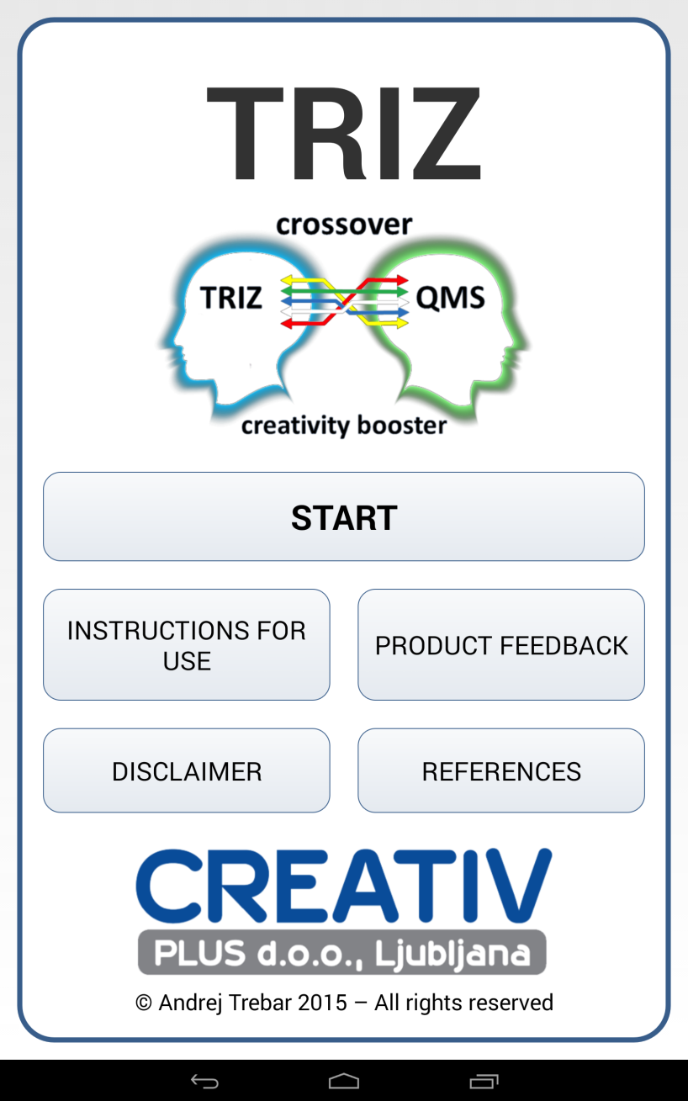
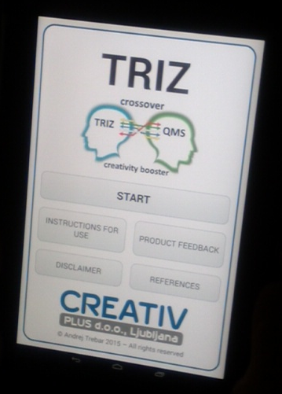
TRIZ crossover QMS application
Notes:
The “TRIZ crossover QMS” application has both educational and problem-solving power. It can be used to foster TRIZ thinking and to accelerate the problem-solving process.
It is easy to navigate and can be used by students to follow teacher during presentation of case studies. This way students become familiar with the use of SW and with TRIZ thinking demonstrated by teacher.
Other benefits of using SW stated by [3]
Provides step-by-step guidance through the problem-solving process
Speeds up the education process
Saves time and eliminates the frustration due to the necessity of selecting the appropriate TRIZ tool to address each particular problem
Reference:
[3] Boris Zlotin and Alla Zusman, Establishing the TRIZ Market, http://www.ideationtriz.com/paper_Establishing_TRIZ_Market.asp

Slide 9
Self study
As mentioned before, to master TRIZ it takes more than listening to two hours lecture. In fact it takes several months of study training materials, theoretical background of TRIZ and a lot of case studies (starting with very simple and proceeding to more complex ones.
Notes:
Resources for self study are: The TRIZ Training Kit , with a supporting resource infrastructure (free resources like The TRIZ Journal at http://www.triz-journal.com/, Time To Innovate with on line contradiction matrix at http://www.time-to-innovate.com/en/steps_matrix, Free TRIZ learning platform for inventors and innovators at http://triz.it/eng/ and others).

Slide 10
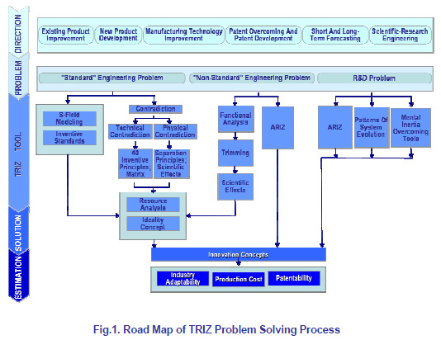
Roadmap of TRIZ Problem Solving Process
Notes:
References:
Valery Krasnoslobodtsev, Richard Langevin, Applied TRIZ In High-Tech Industry, 2006 TRIZ Journal, http://www.triz-journal.com/applied-triz-high-tech-industry/

Slide 11
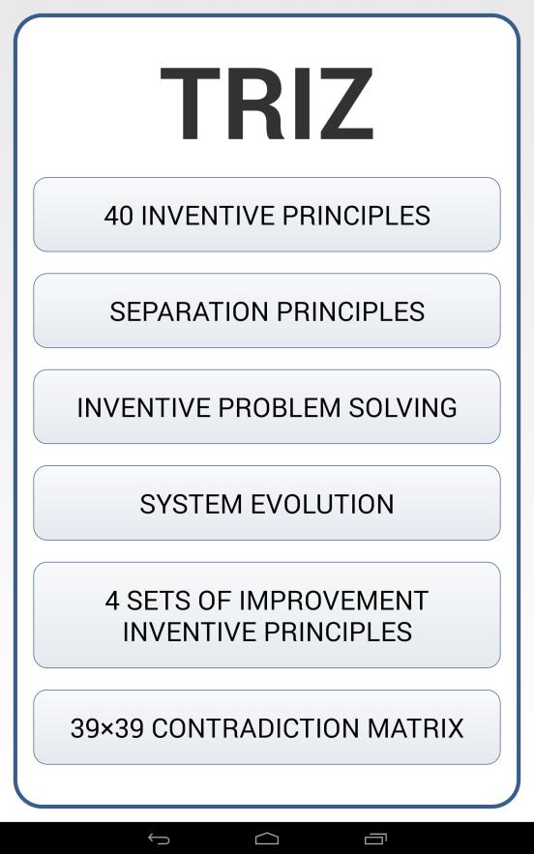
Tools of TRIZ crossover QMS Application accessible by TRIZ menu
Notes:
In “TRIZ crossover QMS” Application menu there is a seven step simplified algorithm for inventive problem solving accessible by taping at INVENTIVE PROBLEM SOLVING button.
References:
[2] Valery Krasnoslobodtsev, Richard Langevin, Applied TRIZ In High-Tech Industry, 2006 TRIZ journal, http://www.triz-journal.com/applied-triz-high-tech-industry/

Slide 12
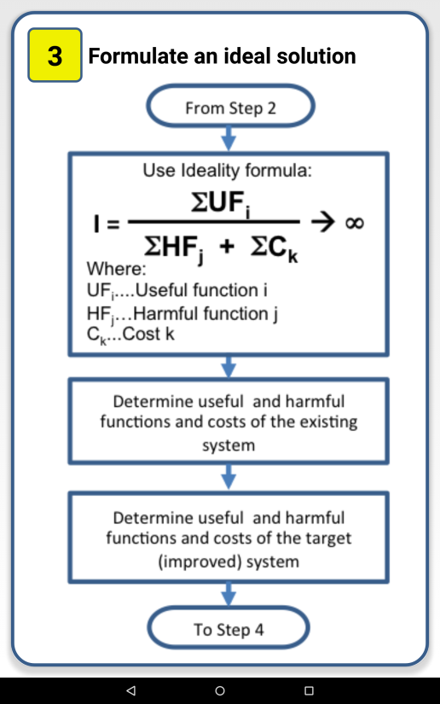
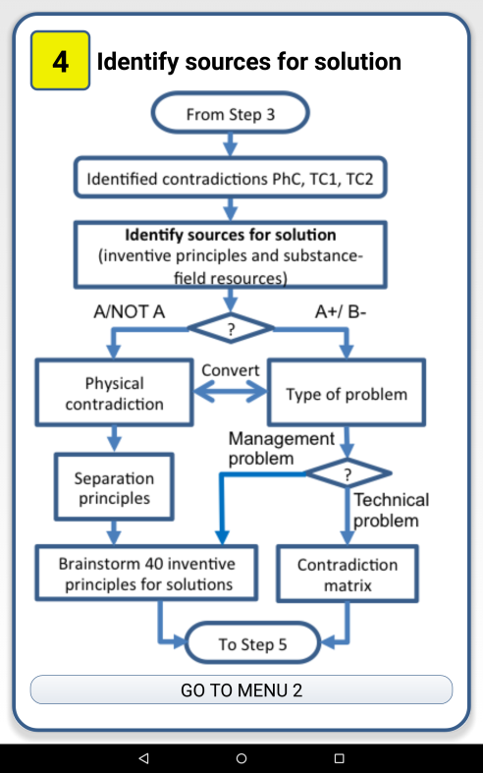
Inventive problem solving algorithm
Notes:
References:
Valery Krasnoslobodtsev, Richard Langevin, Applied TRIZ In High-Tech Industry, 2006 TRIZ journal, http://www.triz-journal.com/applied-triz-high-tech-industry/

Slide 13
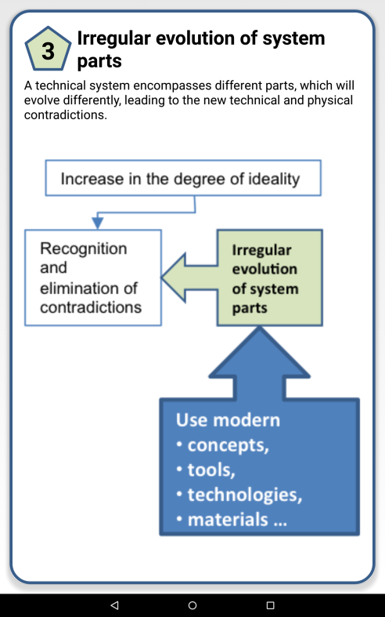
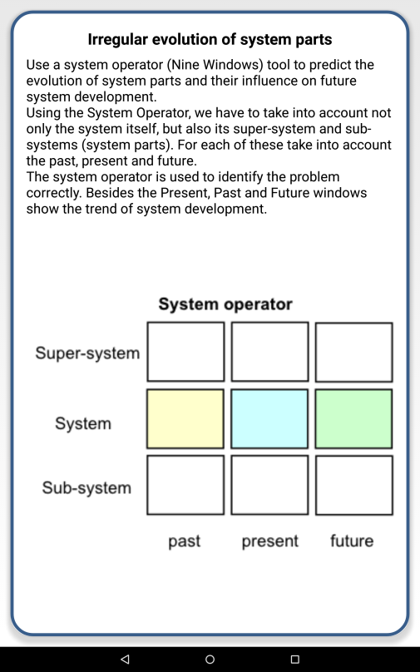
System evolution
Notes:
In “TRIZ crossover QMS” Application menu there are eight cards with system evolution patterns accessible by taping at SYSTEM EVOLUTION button.
References:
Valery Krasnoslobodtsev, Richard Langevin, Applied TRIZ In High-Tech Industry, 2006 TRIZ journal, http://www.triz-journal.com/applied-triz-high-tech-industry/

Slide 14
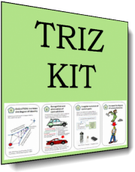
Additional information:
http://www.quality-assurance-solutions.com/TRIZ-training.html
TRIZ Training Kit
A Comprehensive Package to Learn and Train the TRIZ methodology

Slide 15

… and help us to increase value for the customer and reduce harm and costs!
TRIZ increases the speed of system development …

